Slide 1
Climate Modeling
An example of problem solving using computer simulation
Professor Armando Howard

Slide 2
Simulation
To study, understand and predict many real world problems mathematics is necessary.
This is especially true in the sciences.
The mathematics often takes the form of differential equations.
However except for idealized cases the differential equations describing a real problem
Cannot be solved exactly.
One approach is to approximate the problem with a simpler one whose equations can be solved.
Another is to solve the equations approximately,
Transforming differential equations into
Difference equations and doing the many calculations
that result on a computer: Computer Simulation

Slide 3
Time&Space vs. steps and gridpoints
Although in the real world things vary over space and change with time continuously,
The computer has only a finite number of states and can handle only discrete entities.
So in a computer simulation change in time can only be represented step by step : timesteps.
And a simulation describing fields over space can only represent them by values at gridpoints.
Computer resource limitations limit how small we can make the timesteps we evolve the system with
And how closely spaced we make the gridpoints we describe the spatial variation of fields with.
We must also make choices of how we discretize
That is translate differential into difference equations
And these choices can greatly affect the realism of our results and sometimes whether we get any useful result.

Slide 4
Parameterization
Truly complex problems may require taking into account processes that occur on a wide
range of space scales, from very small to very large
And/or on a wide range of time scales, from very fast to very slow.
At a given level of computer technology it may not be feasible to include all processes explicitly
Since the number of grid-points and/or the number of time-steps would become too large to get results.
The smallscale/fast processes which cannot be resolved nevertheless can have important effects
even on the largescale/slow behavior that is resolved.
Parameterizations, submodels that describe the effects of the unresolved scales on the resolved scales,
must therefor be developed and used in order to get reasonably realistic results with reasonable use of computer resources .

Slide 5
Community Effort
Reliable parameterizations require both skilled knowledge of the processes and much effort.
In the most complex systems there are a very large number of relevant processes
Not all of them may even be yet known.
To model such a system is beyond the ability of any individual scientist however gifted.
The lone hero of science-historical lore must thus be replaced by a dedicated community effort.
Despite the great human resources involved in tackling huge complex problems by Computer Simulation
Is nevertheless worthwhile, because without it we would not be able to understand and predict
Real world systems of great importance.

Slide 6
Climate Modeling
The glaring example of this is the Climate System.
It not only affects our lives, in the long run it determines the habitability of our planet.
However the differential equations which would describe the climate system would be too complicated to even pose in a realistic case
Let alone solve analytically.
There are huge ranges of scales e.g. tiny droplets forming in a cloud & huge monsoon wind patterns
Rapid turbulence & millennial ocean ventilation.
Climate Modeling requires Computer Simulation.

Slide 7
Climate Change
We know that climate, the patterns over many years in the weather, changes in a given region.
We also know that even the global climate, the world aggregate of the regional climates
Has changed in the past: Ice Ages & Warm Periods
However we know that Greenhouse gases
Such as water vapor, carbon dioxide and methane,
which act like blankets in our atmosphere preventing infrared from escaping, affect climate.

Slide 8
Greenhouse gases
Water vapor is in balance with liquid water at a given temperature
But carbon dioxide & methane were implicated in climate change in the past
And have suffered an unprecedentedly rapid increase due to our use of fossil fuels, and this increase is still ongoing
Even while its effects on climate have only begun to be felt.
Anthropogenic, that is man-made, climate change is already a reality.
Part of our knowledge of these things rests on observations, and part on theory, but a large part is also from the results of Climate Modeling via Simulations.
Observation, Theory and Simulation all three combined => knowledge.

Slide 9
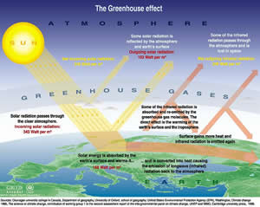

Slide 10
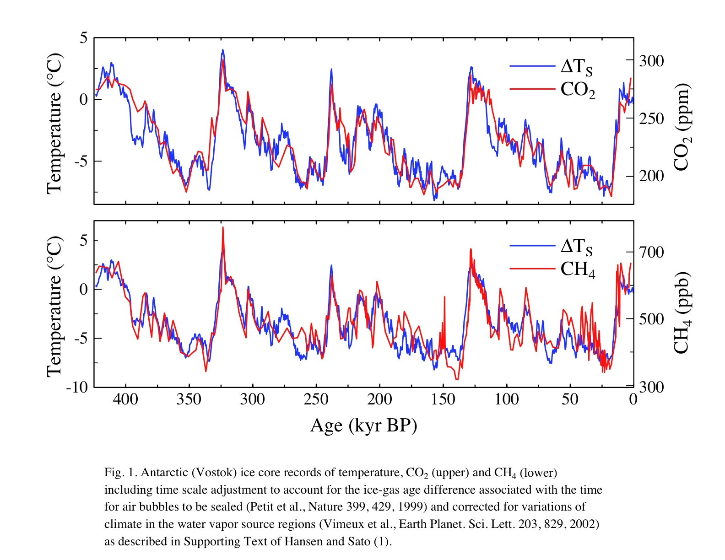

Slide 12
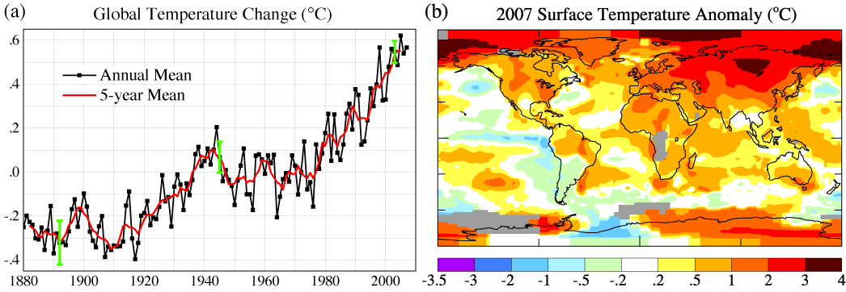
Temperature vs. 1950-1980

